Slide 1
Opinion Essay for Final Assessment

Slide 2
250 – 300 words

Slide 3
Examples of questions
What is your opinion?
Do you agree or disagree?
To what extent do you agree or disagree?

Slide 4
A big salary is much more important than job satisfaction. Do you agree or disagree?

Slide 5

How to write an essay: Step 1 Decide on your opinion

Slide 6

Step 2:
Brainstorm ideas and choose two of them

Slide 7
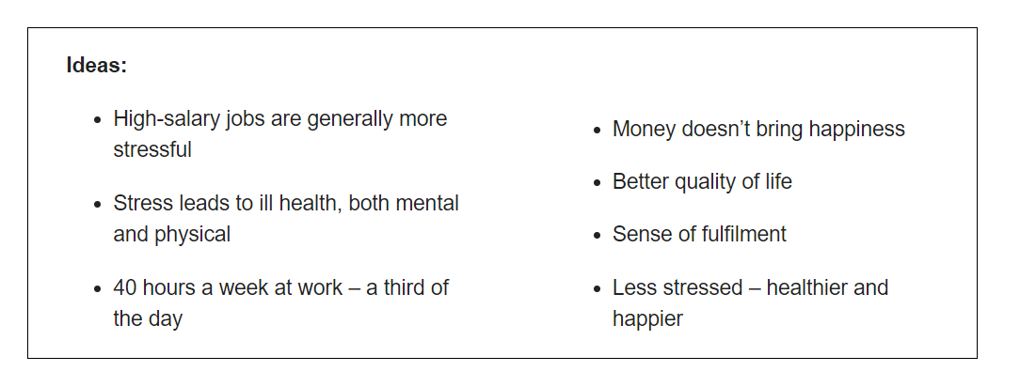
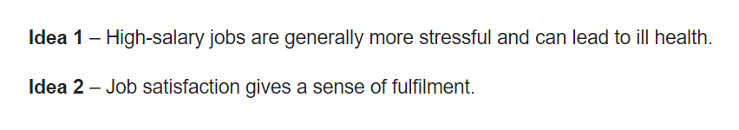

Slide 8
Introduction

Slide 9
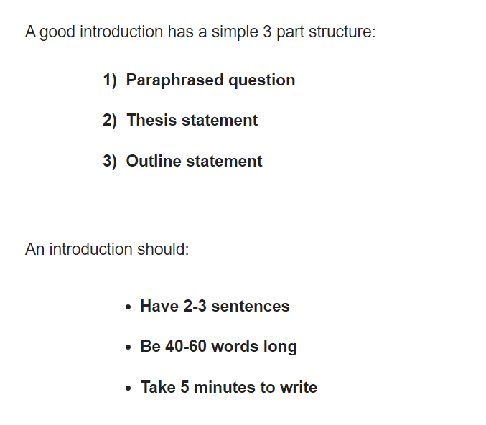

Slide 10
Paraphrase the question
A big salary is much more important than job satisfaction. Do you agree or disagree?
->
It is argued that earning lots of money has more significance to people than being content in their work.

Slide 11
Thesis statement
This essay totally disagrees with that statement. OR
This essay completely agrees with that statement.

Slide 12
Outline your future ideas in one sentence
I believe that people are increasingly concerned about the risk of stress-related ill-health frequently experienced by people in highly paid positions and they care more about feeling fulfilled at work.

Slide 13
Outline your future ideas in one sentence
I believe that people are increasingly concerned about the risk of stress-related ill-health frequently experienced by people in highly paid positions and they care more about feeling fulfilled at work.

Slide 14
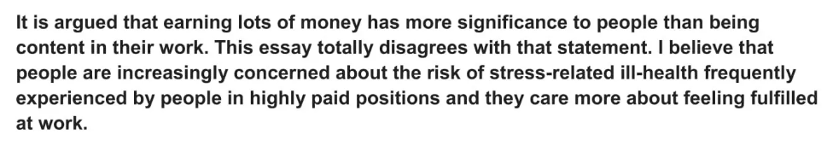

Slide 15
Main body How many paragraphs are there?

Slide 16
Main body (wow)
Topic sentence
Explanation
Example

Slide 17
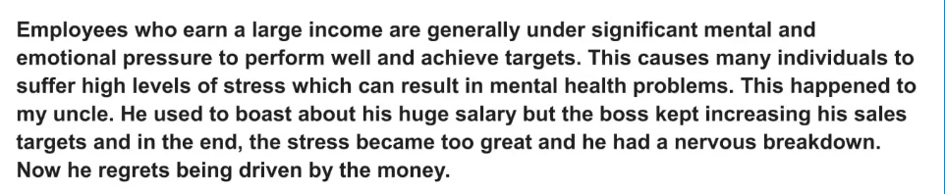
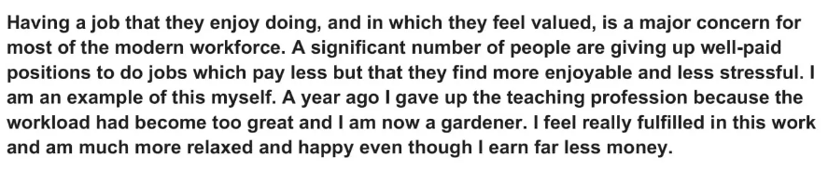

Slide 18
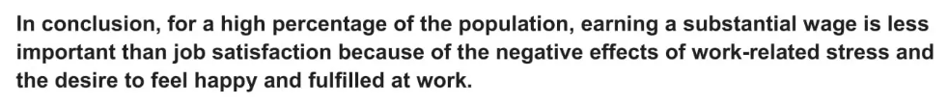
Conclusion
Summarise the main points
State your opinion

Slide 19
